Slide 1

The Odoo Javascript Framework
Odoo Web Library (OWL)
Mohammed Shekha – Senior Application Engineer
Soumya Mukherjee – Application Engineer

Slide 2


What is OWL?

Slide 3


Compact UI Marvel
Brilliance
With Simplicity
React-Vue Fusion
Modern, Elegant, Fast

Slide 4


Challenges

Slide 5
DOM Manipulation Nightmare
Component Fragmentation
State Management Complexity
UI Updates Bottleneck
Complex UI Interaction
Slower Performance
Before OWL

Slide 6
DOM Manipulation Nightmare
Component Fragmentation
State Management Complexity
UI Updates Bottleneck
Complex UI Interaction
Slower Performance
Virtual DOM Handling
Modular Architecture
OWL state management
Optimised rendering
OWL Lifecycle hooks
Faster Performance
Before OWL
After OWL

Slide 7
The Comparison
Aspect | OWL | React | Vue
Modularity | Extremely Modular | Modular | Modular
Tooling | Min. Mandatory Tooling | Rich Ecosystem and Tooling | Rich Ecosystem and Tooling
Template Language | XML Based | JSX or Custom Templates | JSX or Custom Templates
Template Compilation | Complies at Runtime | Compiles ahead of time | Compiles ahead of time
Reactivity | Explicit reactivity system | Reactive by default | Reactive by default
Developer Experience | Simplified API with Classes | Can be overwhelming for non-JS specialist | Can be overwhelming for non-JS specialist

Slide 8
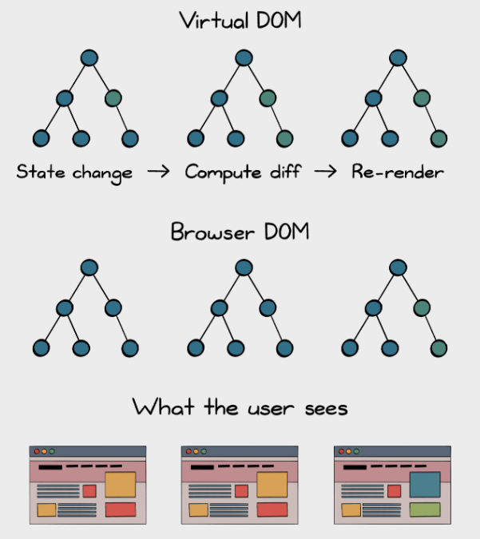
How do we manage UI?
< Current DOM
< Change Detected

Slide 9
VDOM vs DOM
Aspect | VDOM | DOM
Purpose | Intermediary for efficient updates | Live web page structure
Performance | Optimizes updates | May lead to performance bottleneck
Manipulation | Efficient updates w/o direct DOM changes | Requires direct manipulation
Memory Management | Helps minimize memory leaks | Requires careful handling
Browser Interaction | Not visible in browser | Direct Interaction
Cross-platform Usage | Used in Server Side Rendering, Mobile Apps | Primarily Web Browsers

Slide 10

The Auction Odyssey
Introduction

Slide 11


User Story

Slide 12


“I'm craving an Auction website that outshines the competition – sleek, seamless, and faster to launch.
Building this from scratch sounds crazy. Can your OWL magic cook up something? Ready to be wowed!”
User Story
Alex
Founder, The StartUp

Slide 13

What should we expect?
The Product
Designed by Manushi Shah - Jr. Application Engineer

Slide 14

OWL Basics
The Beginning

Slide 15
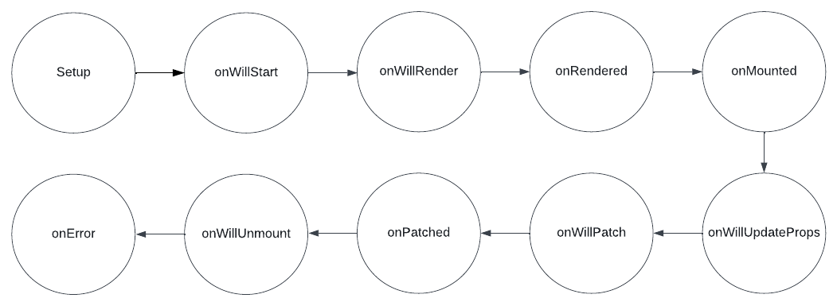
Components Lifecycle

Slide 16
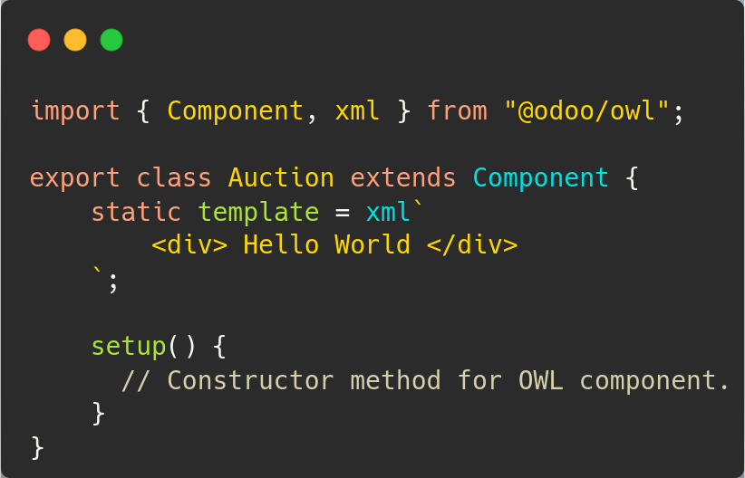
OWL Component
A modular unit bundling functions and UI elements.

Slide 17
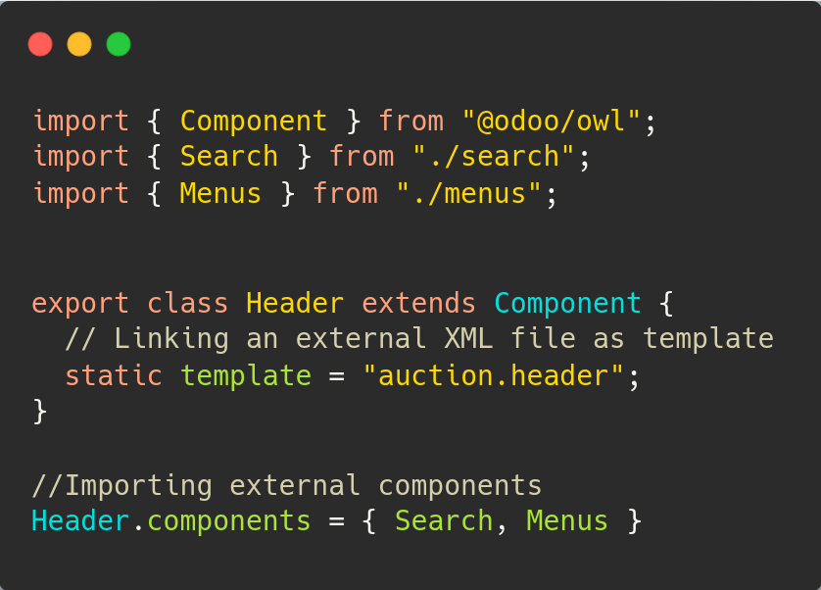
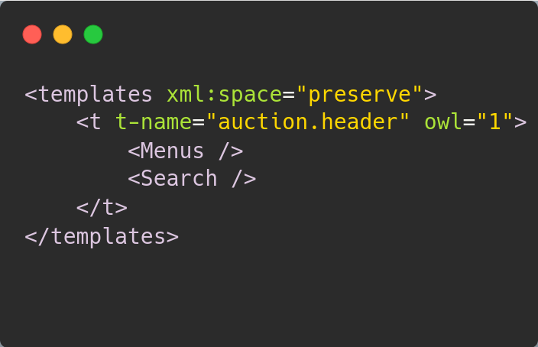

OWL Sub - Component
XML
JS Logic

Slide 18
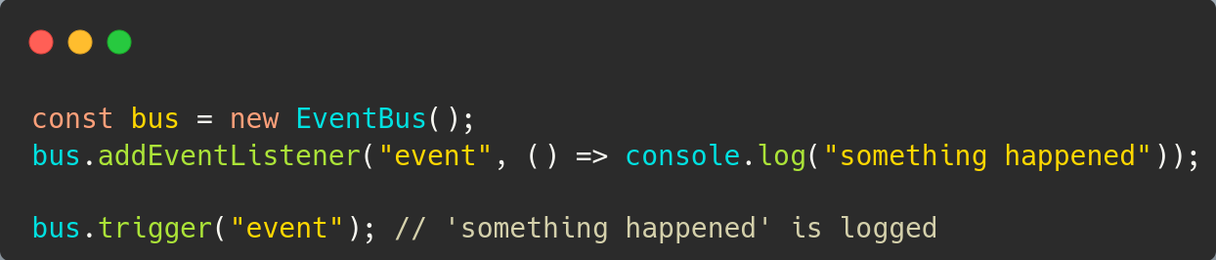
Event Bus

Slide 19


Environment
Easy to mount with any Application
Can be used by all the Components
Stays in a Shallow Frozen state
Application
Environment Variable

Slide 20
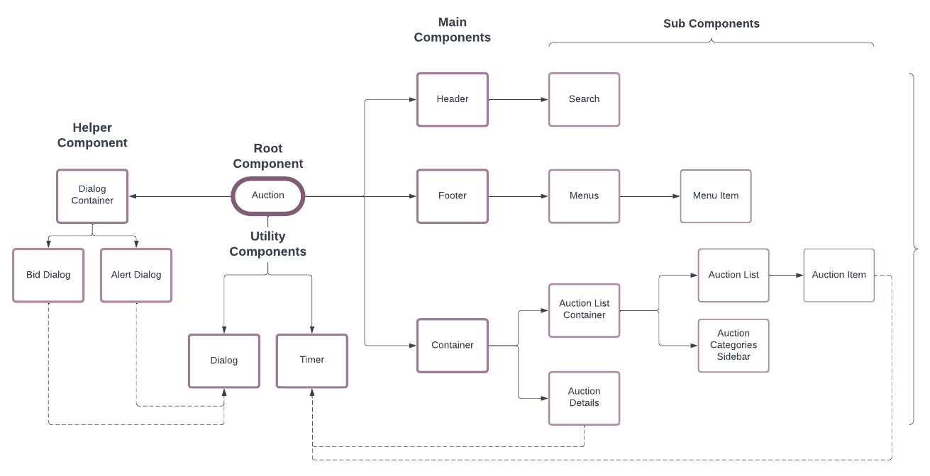
Architecture Design

Slide 21
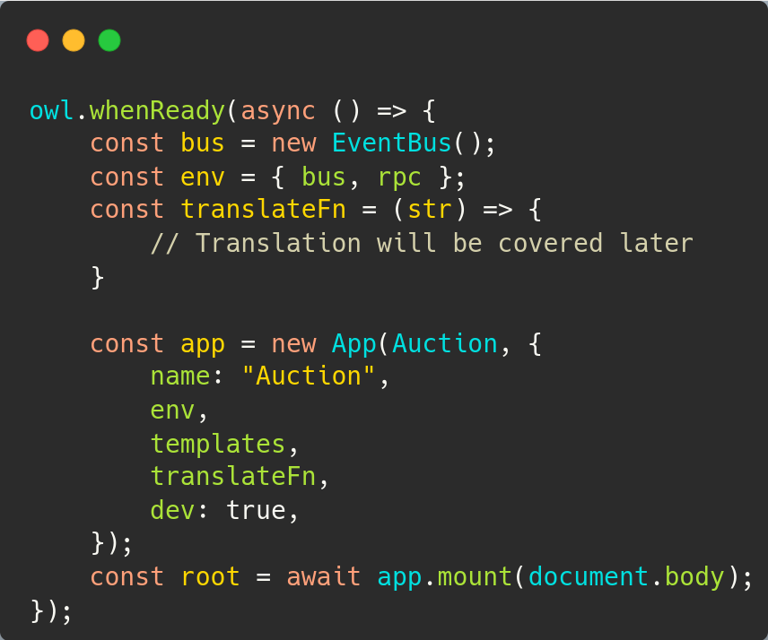
Setting up application
To load component mount is used.
Binding all components, under an App helps in environment management.
Here we can also see an implementation of whenReady hook.

Slide 22

Root Component
Auction

Slide 23
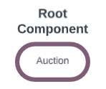
Architecture Progress

Slide 24
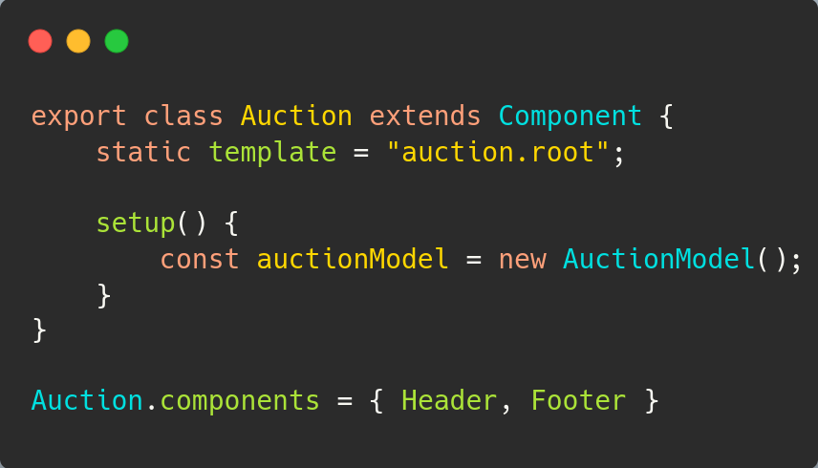
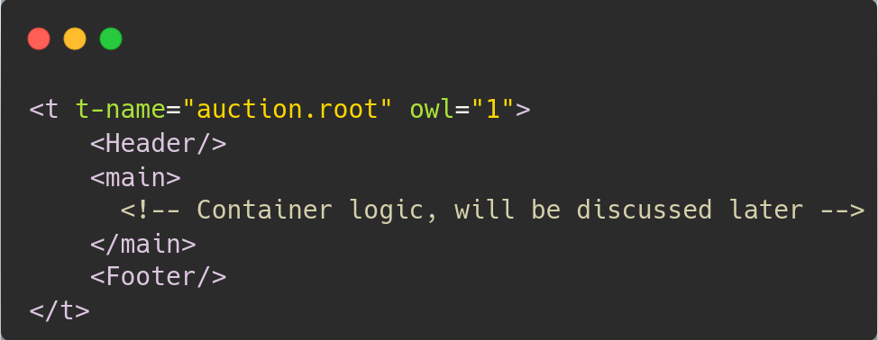
Root Component (Auction)
Here, we can see the implementation of Sub-Components
JS - Logic
XML - UI

Slide 25
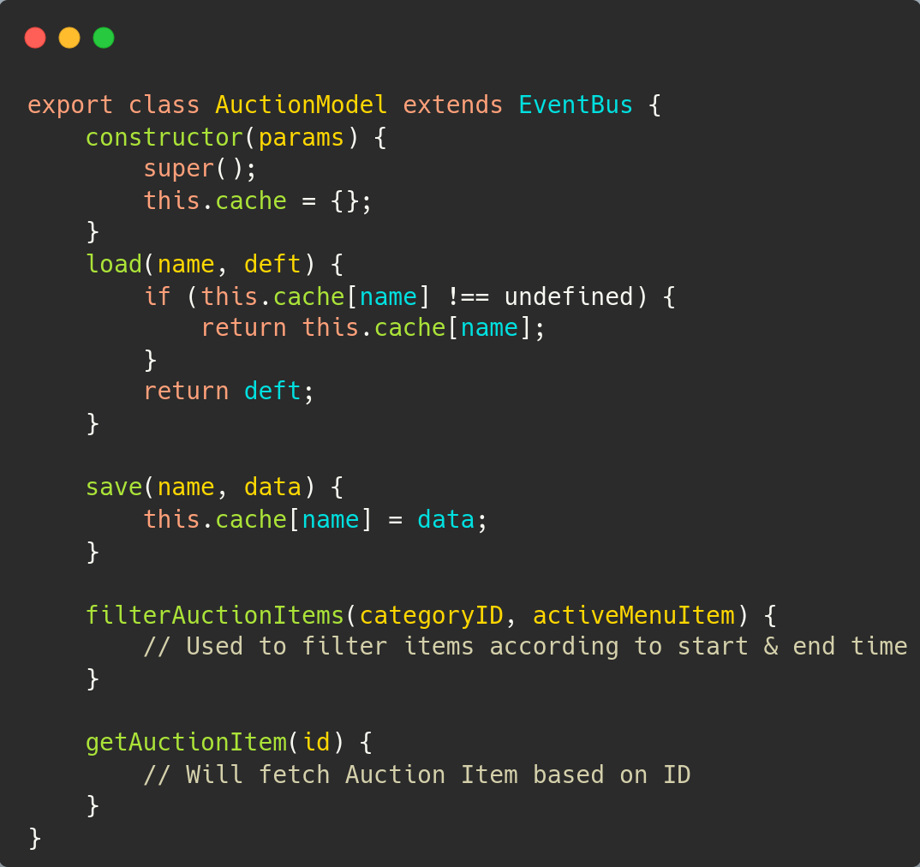

Implementing EventBus

Slide 26
Header Component
Auction > Header

Slide 27
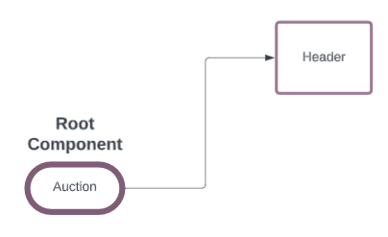
Architecture Progress

Slide 28
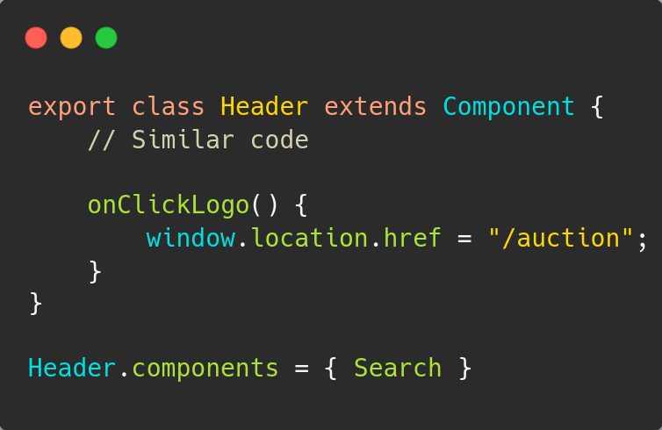
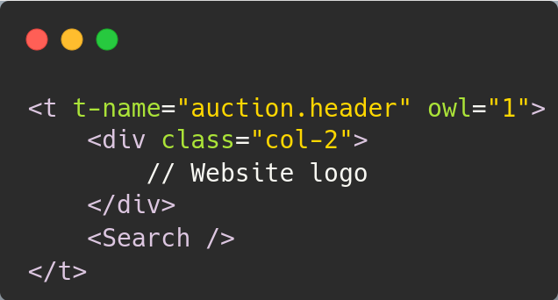
Header Component
Here, a similar implementation but with a t-on-click event
JS - Logic
XML - UI

Slide 29
Search Component
Auction > Header > Search

Slide 30
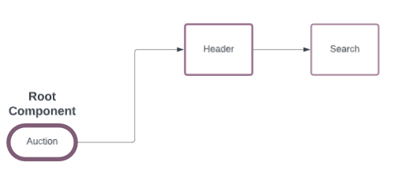
Architecture Progress

Slide 31
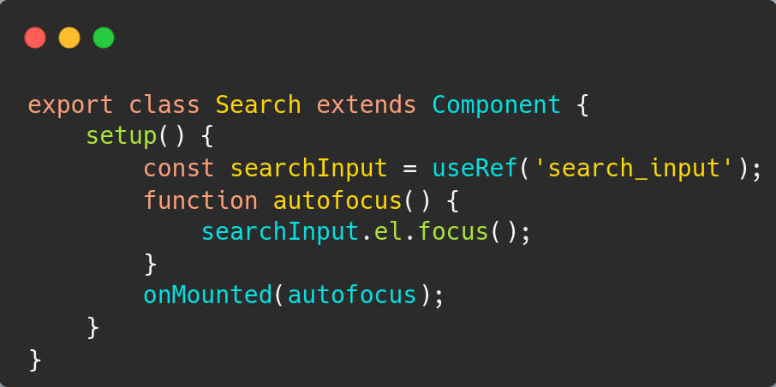
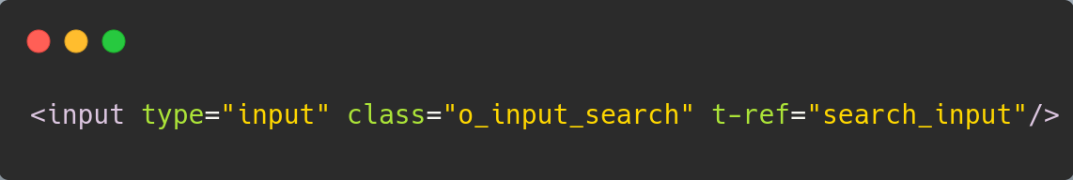
Search Component
Here we can see implementation of two Hooks:
useRef
onMounted
JS - Logic
In order to use useRef, set t-ref on the element
XML - UI

Slide 32
Menu Component
Auction > Footer > Menus

Slide 33
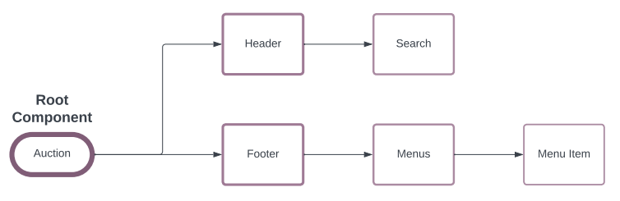
Architecture Progress
Like previous components, these components offers same sub component features.

Slide 34






Let’s talk about Props
Data
Component A with Data
Sending data to Component B
Component B with same Data

Slide 35
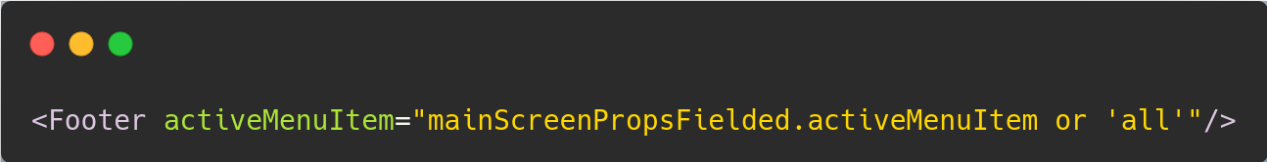
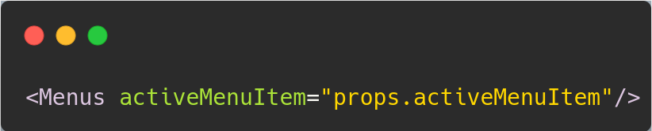
Implementation of Props
File: Root Component
File: Footer Component

Slide 36
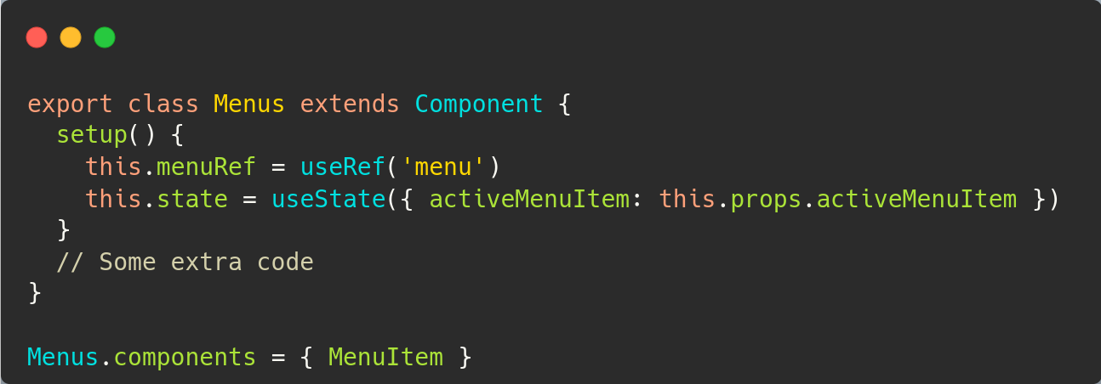
Menus Component
Now, the props has reached its destination. Time to use state management for better UI updations.

Slide 37
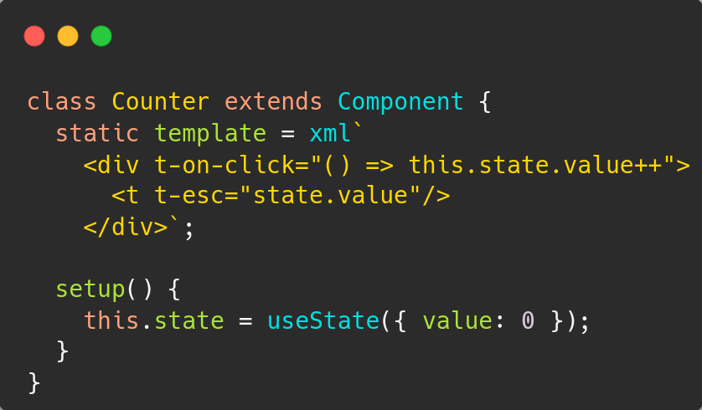
Special Topic: useState
Helps in controlling - state of variables, and rendering responsible component

Slide 38
Screen: Auction List Container
Auction > Container > Auction List Container

Slide 39
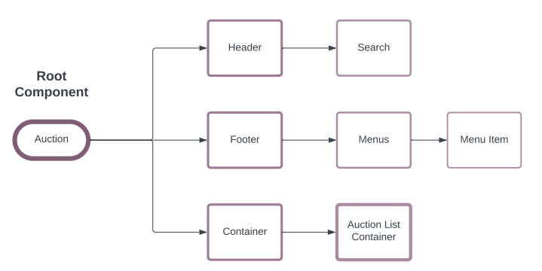
Architecture Progress

Slide 40
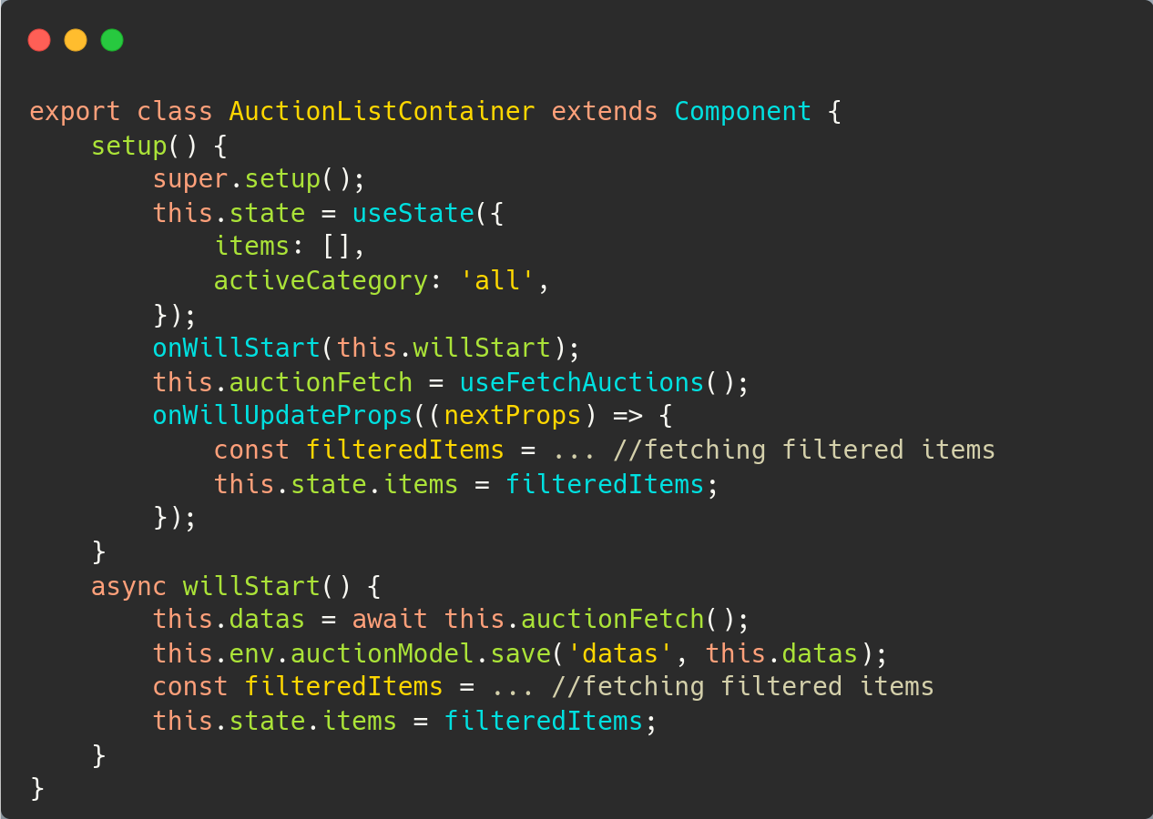
JS Logic
Implementation of hooks:
useState
onWillStart
onWillUpdateProps
JS Logic

Slide 41
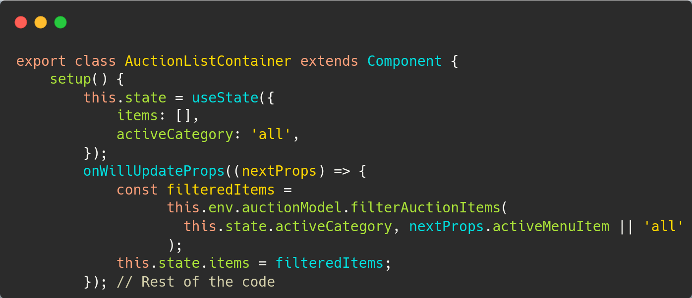
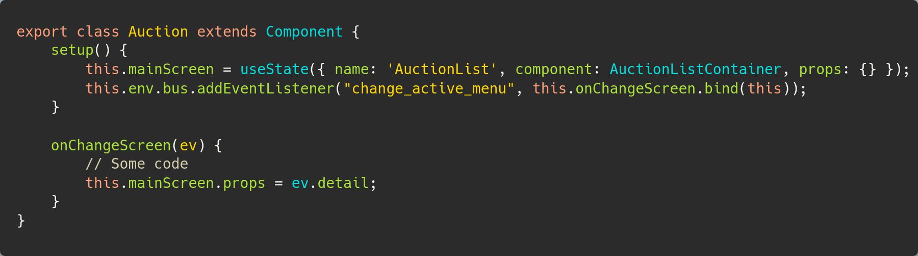
Special Topic: onWillUpdateProps
Clicking on a MenuItem triggers change_active_menu
Which updates main Props
Triggering onWillUpdateProps

Slide 42
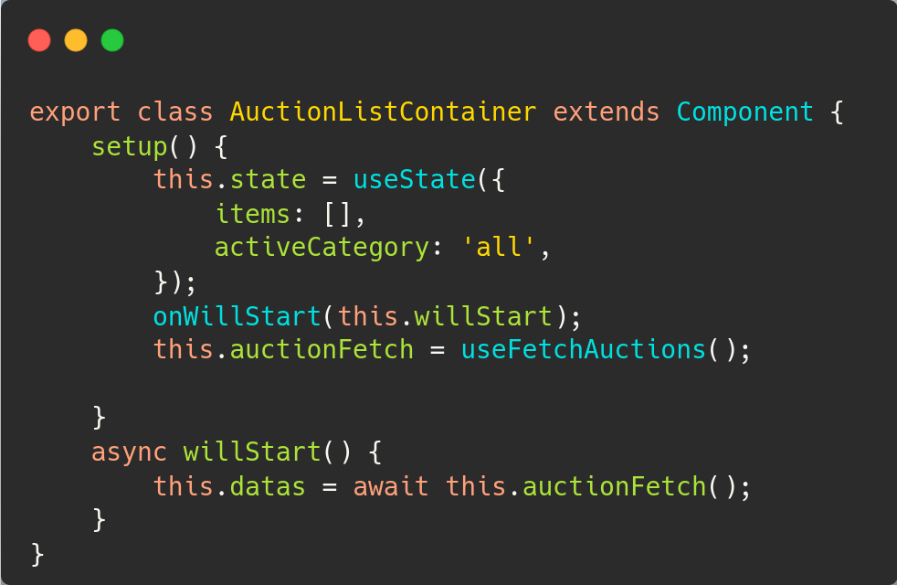
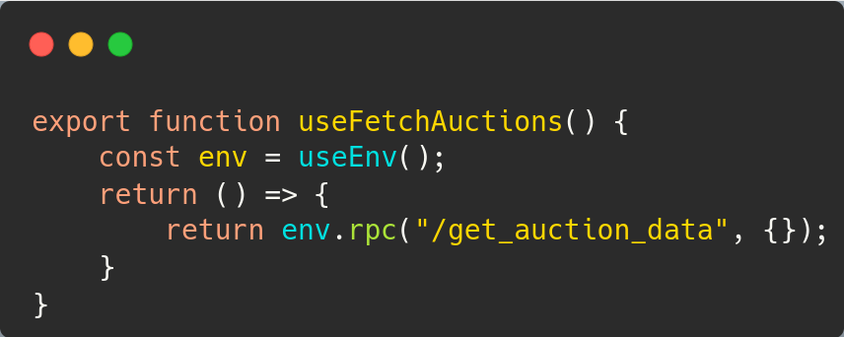
Custom Hook
Here we can see implementation of
useEnv hook
Calling Method
Custom Hook

Slide 43
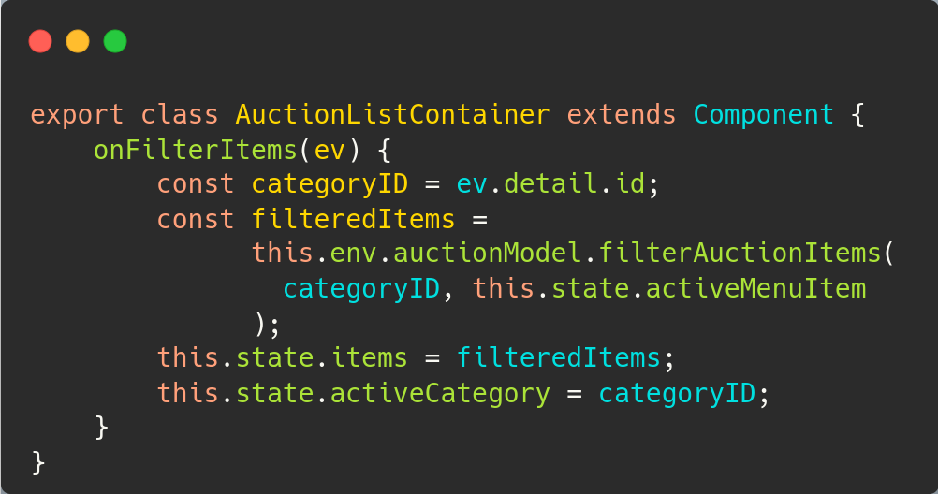
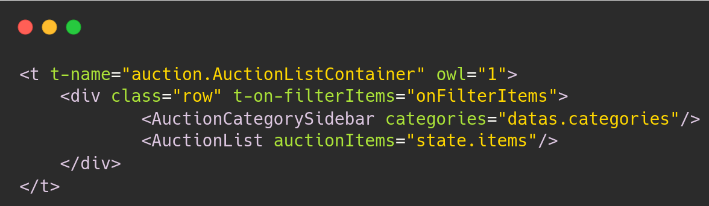
Understanding Custom DOM Event
Continuing previously discussed code,
Here is a proper use case of useState
Here, a custom DOM event is patched with OWL
t-on-filterItems

Slide 44
Auction Categories Sidebar
Auction > Container > Auction List Container > Auction Categories Sidebar

Slide 45
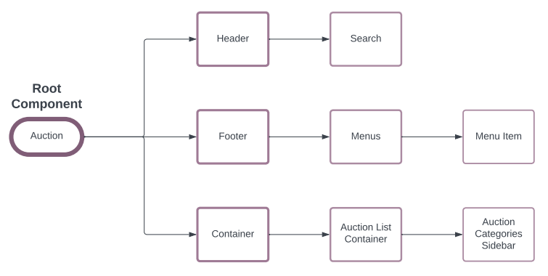
Architecture Progress

Slide 46
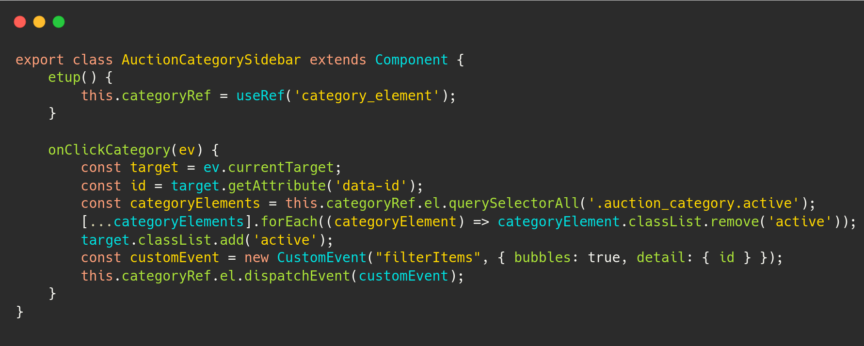
Understanding CustomEvent Logic
Note: This method is triggered using “on click” event on any Category

Slide 47
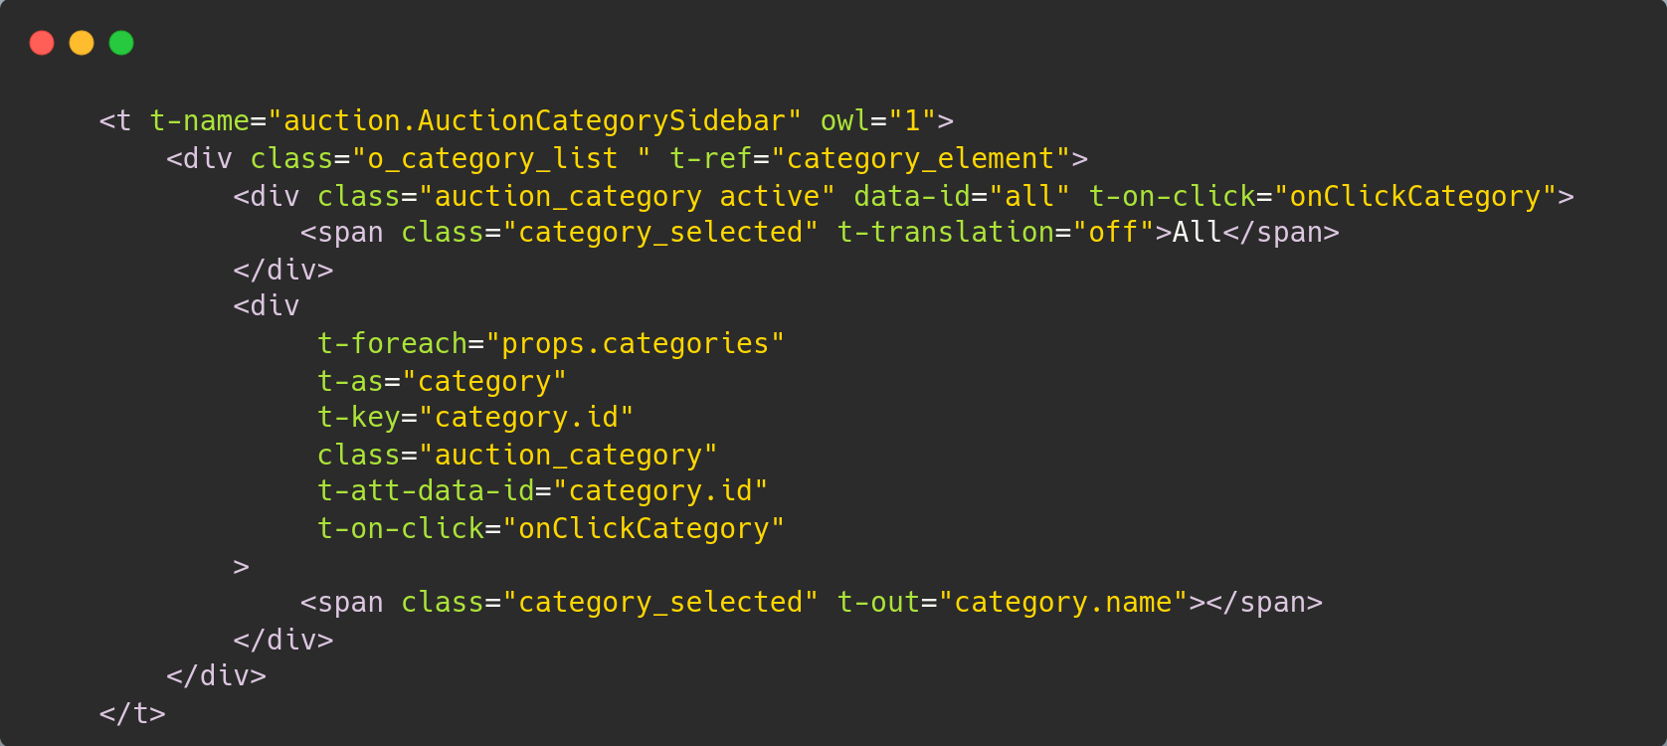
Understanding CustomEvent XML

Slide 48
Auction List
Auction > Container > Auction List Container > Auction List

Slide 49
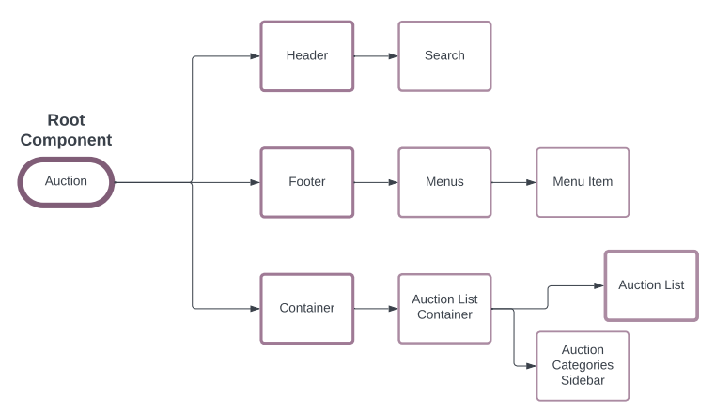
Architecture Progress
Like previous components, this component offers same sub component features.

Slide 50
Auction Item
Auction > Container > Auction List Container > Auction List > Auction Item

Slide 51
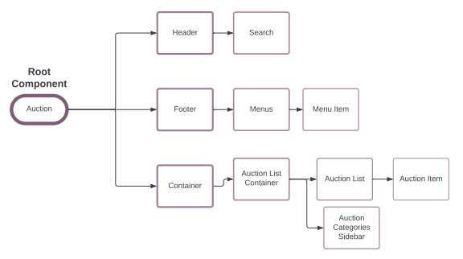
Architecture Progress

Slide 52
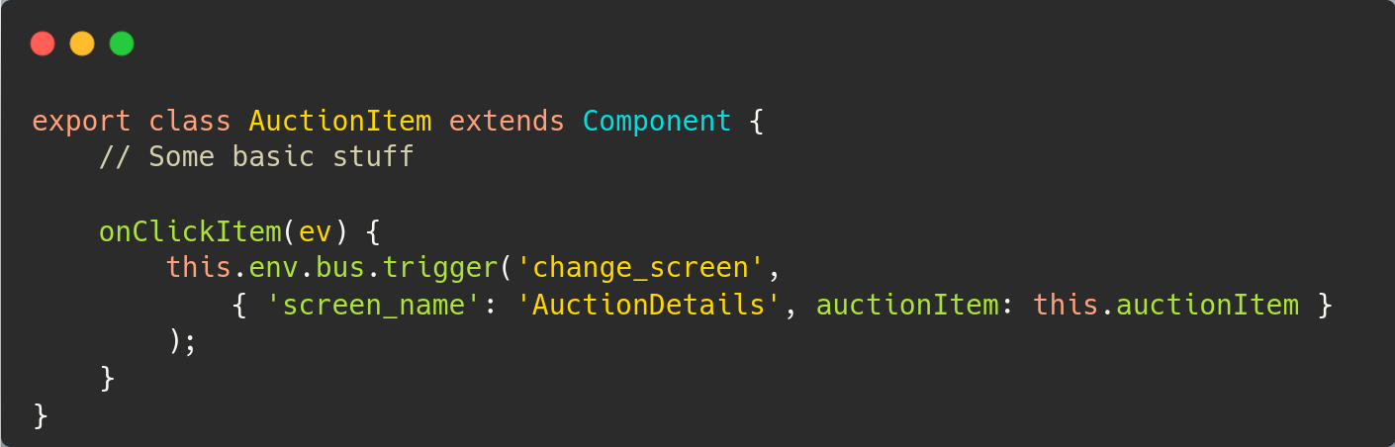
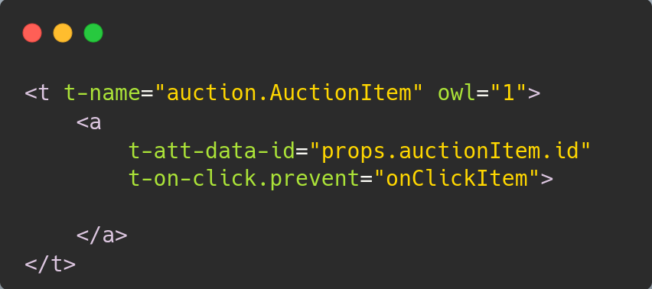
Auction Item Component
This change depends on EventBus application
Here, we can see implementation of
trigger method, which is a part of
OWL EventBus feature

Slide 53
Modifying Root Element
Auction

Slide 54
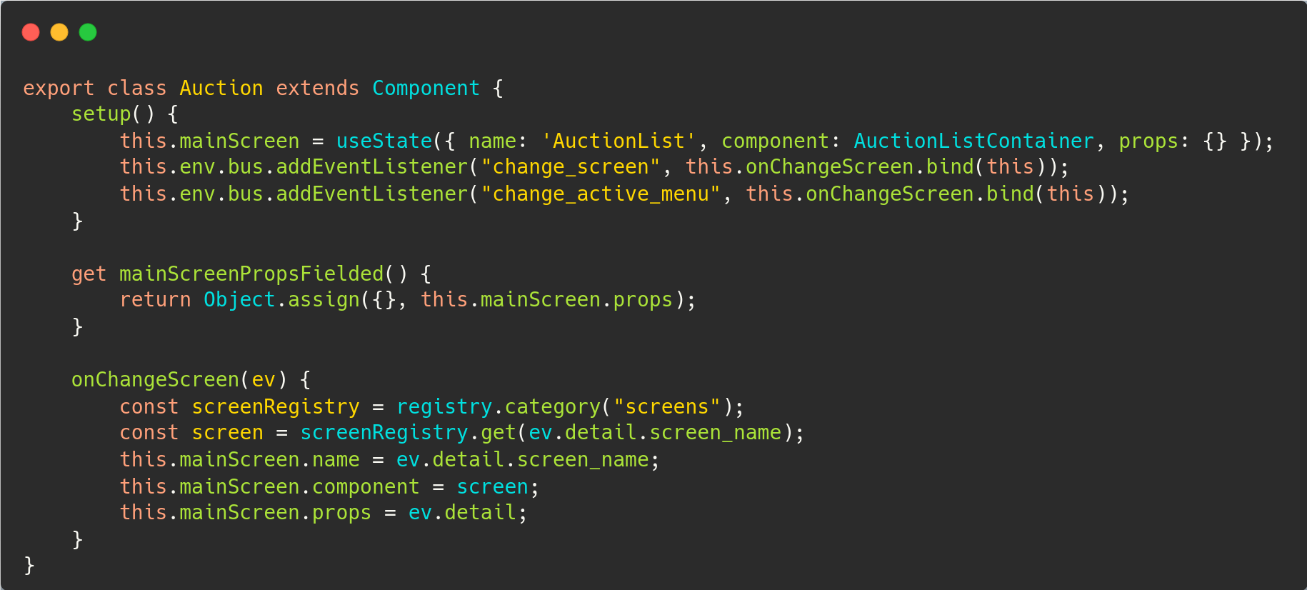
Understanding EventBus Event Handling

Slide 55
Timer Component
Auction > Timer

Slide 56
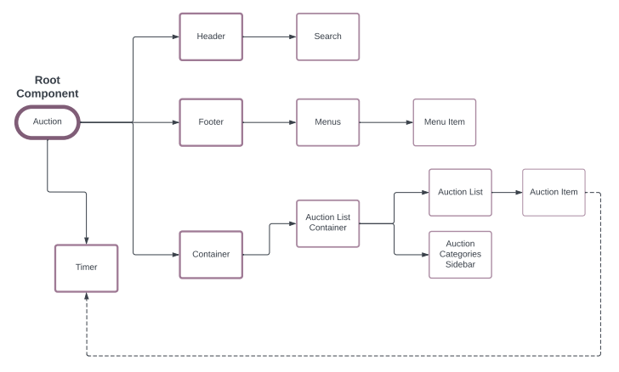
Architecture Progress

Slide 57
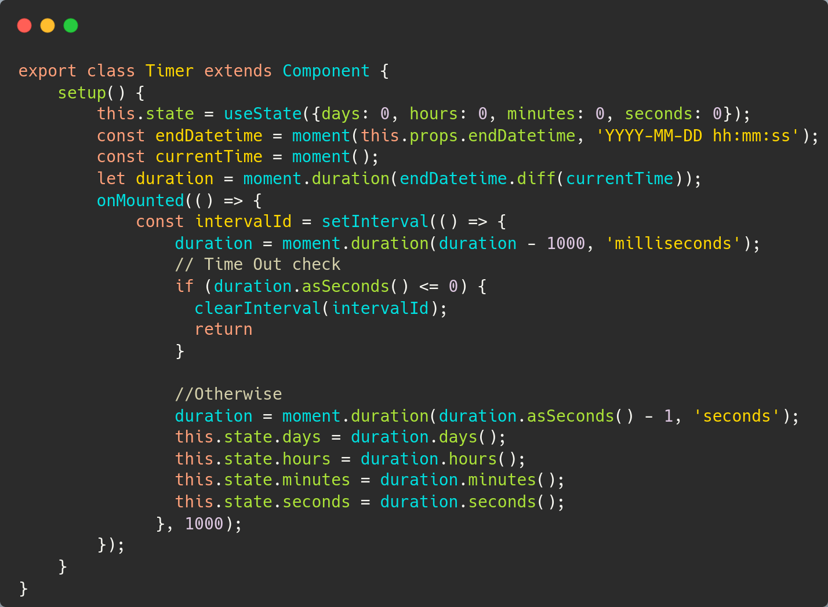
Timer Component
Another implementation scenario for hooks:
useState
onMounted

Slide 58
Screen: Auction Details
Auction > Container > Auction Details

Slide 59
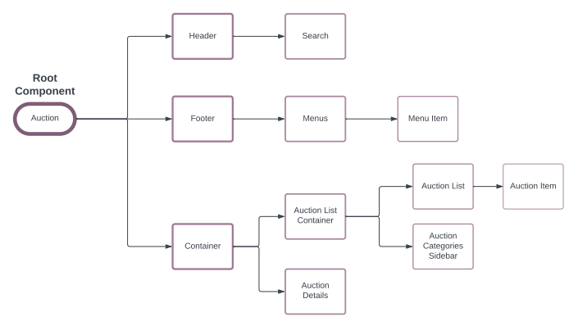
Architecture Progress

Slide 60
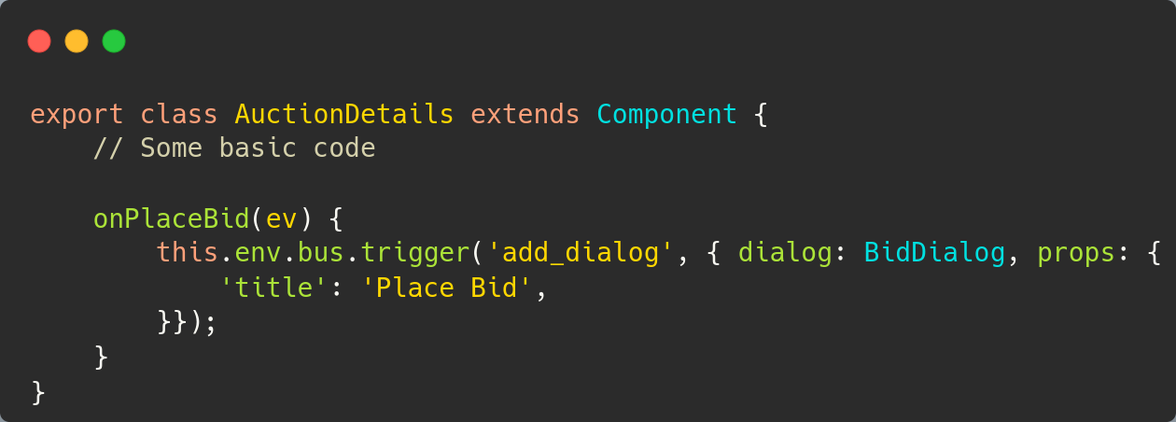
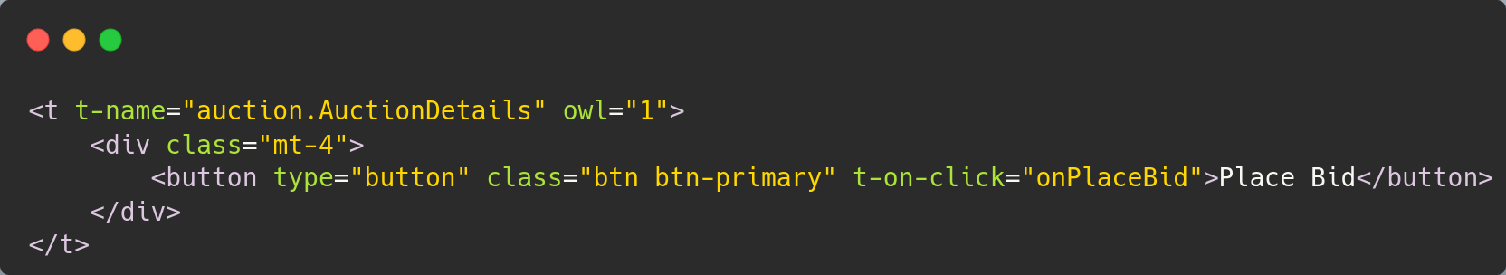
Auction Details Component
Similar implementation of OWL EventBus

Slide 61
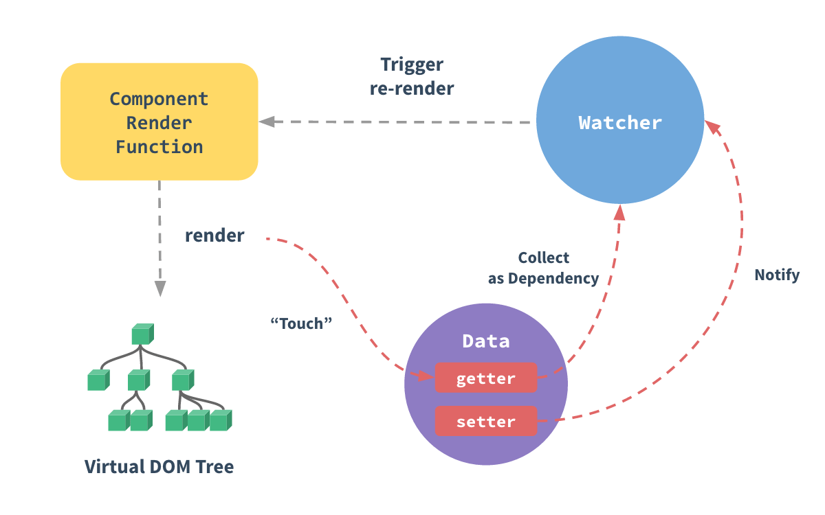
Special Topic: Reactive

Slide 62
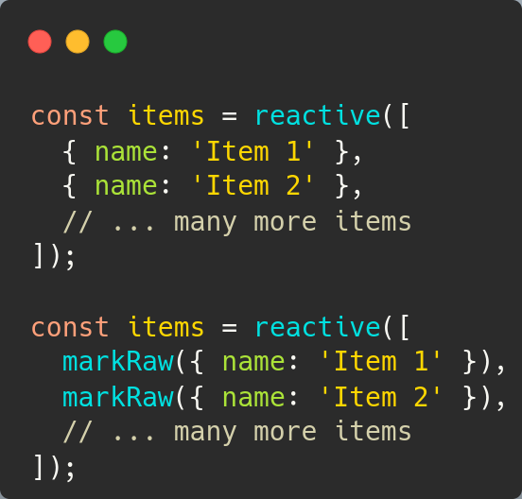
markRaw
Performance: Prevents the creation of unnecessary reactive objects.
Immutability: Ideal for objects known to be immutable.
Control: Mark objects that should not trigger reactivity.

Slide 63
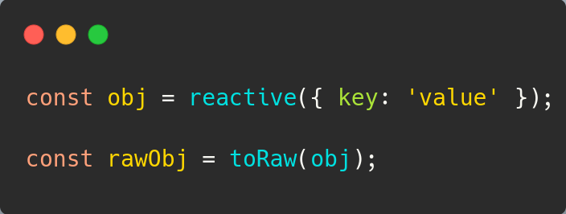
toRaw
Debugging: Inspect the original object without proxy complexity.
Accessing Data: Retrieve the raw, non-reactive data from reactive proxies.
Comparisons: Ensure equality between the original and the proxy object.

Slide 64
Modifying Root Element
Auction

Slide 65
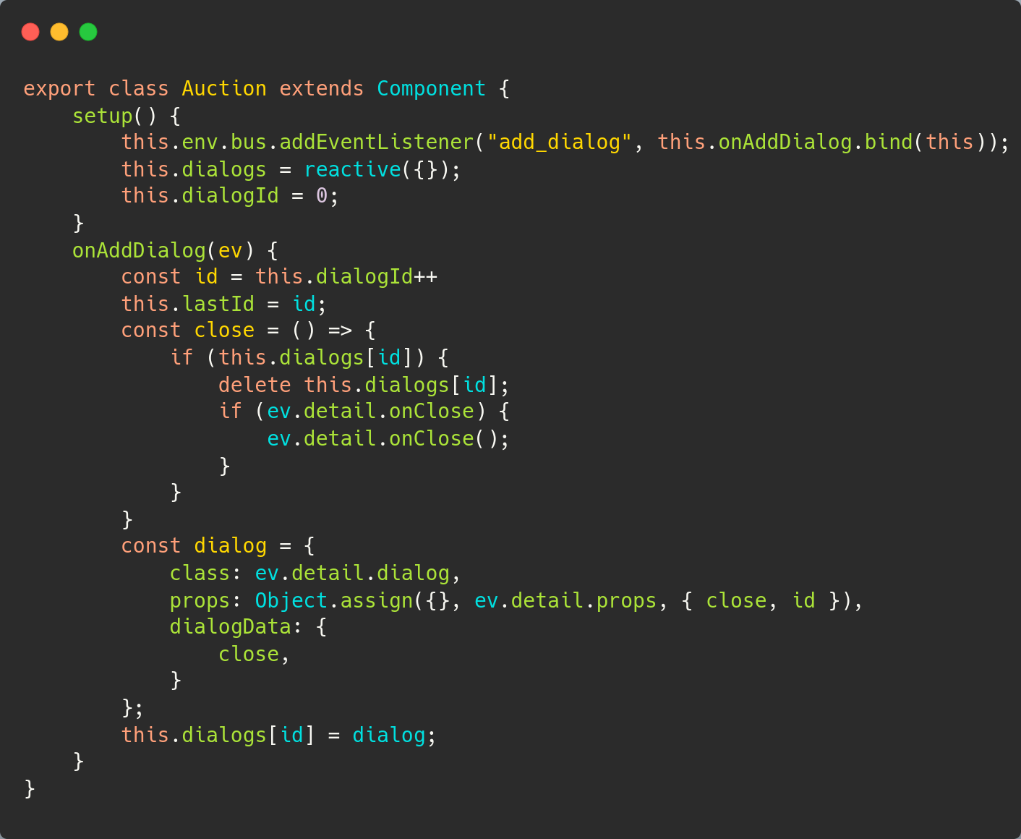
Root: Adapting new changes
Here, we can see a similar implementation of handling custom events using EventBus.
We can also see implementation of reactive hook.

Slide 66
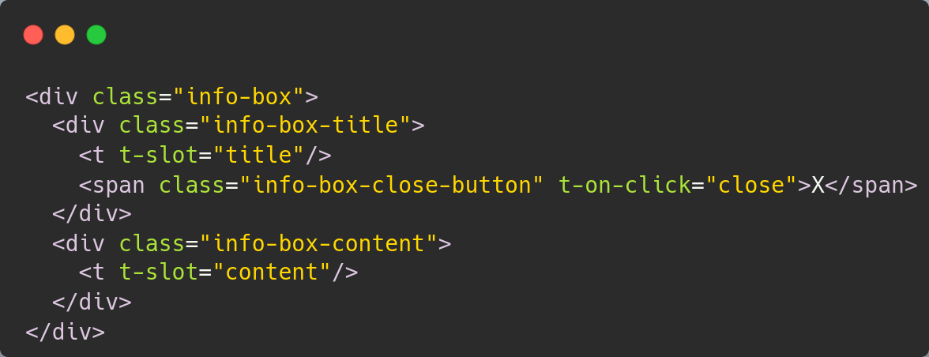
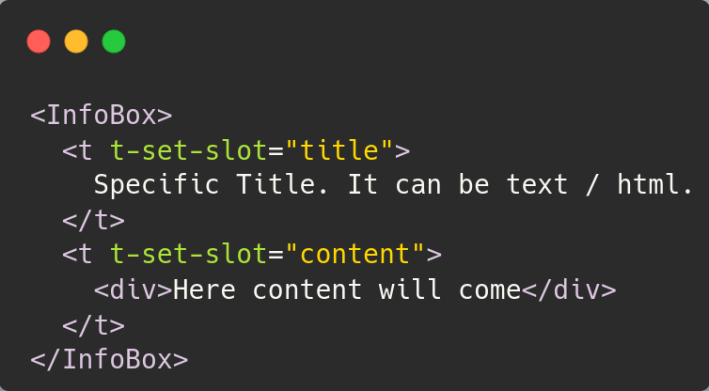
Special Topic: Slots
Setting up slots in a component
Using it from a different component

Slide 67
Dialog Container Component
Auction > Dialog Container

Slide 68

Architecture Progress

Slide 69


Understanding Sub Environments
Here, we can see implementation for two new Hooks:
onError
useSubEnv
Using useSubEnv one can create a dynamic environment for specific components

Slide 70

Dialog Container UI - XML
Here, we can see the effect of useSubEnv on Dynamic Components

Slide 71
Dialog Component
Auction > Dialog

Slide 72
Architecture Progress

Slide 73

Dialog Component
Here, we can see usage of useExternalListener hook

Slide 74

How Slots helped us!

Slide 75
Dialog: Bid Dialog Component
Auction > Dialog Container > Bid Dialog

Slide 76

Architecture Progress

Slide 77


Bid Dialog Component
Implementation from Auction Details Screen
Here, we can see couple of different concepts:
EventBus Trigger
Slots

Slide 78


Props Validation

Slide 79
Translations

Slide 80

Translations
Setting up translation configuration
Adding an exclusion

Slide 81
Let’s Test

Slide 82

Configuring QUnit Test Suite

Slide 83

QUnit Test

Slide 84

Helper Test Methods

Slide 85
Integration with Odoo

Slide 86

JS - Logic

Slide 87

JS - Props Validation

Slide 88

XML - UI Implementation

Slide 89

XML - Backend

Slide 90





Let’s check out our Website
Your Name
Your Title (APAC)
Contact Us
Email address
Skype id
Live Webinar

Slide 91
Unveiling the Power of OWL
The Conclusion

Slide 92
Some Power Stats
Points | Regular JS | OWL
Development Time | 3-4 days | 16 hours
Learning Curve | Familiar | Moderate
User Interface (UI) | Manual styling | Component-based
Code Reusability | Low | High
Maintenance | Manual updates | Easier updates
State Management | N/A | Built-in support
Performance Optimization | Manual efforts | Optimized by default

Slide 93



Questions?
Book a free demo with an expert.

Slide 94

Thank You
Checkout our documentations:
https://github.com/odoo/owl
Checkout our demo application:
https://github.com/somu-odoo/OXP

